Slide 1
Saline Lakes Land Ownership Visualizations

Slide 2
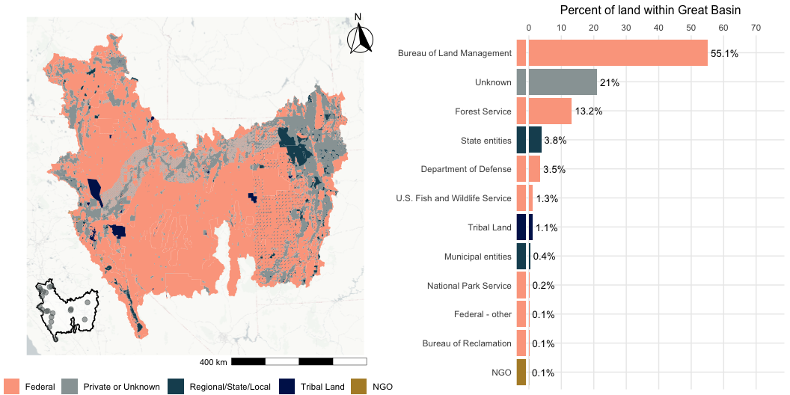
Great Basin

Slide 3
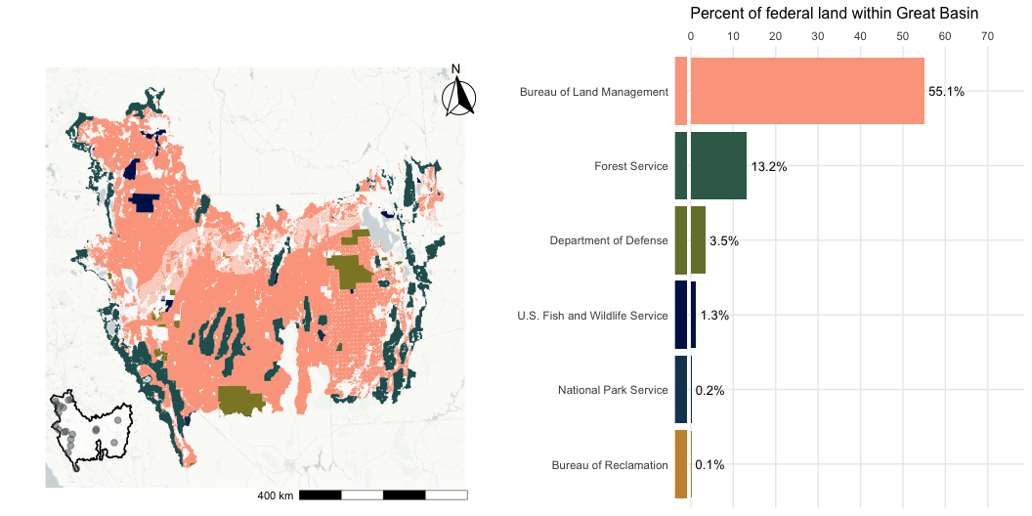
Great Basin - Federal Lands

Slide 4
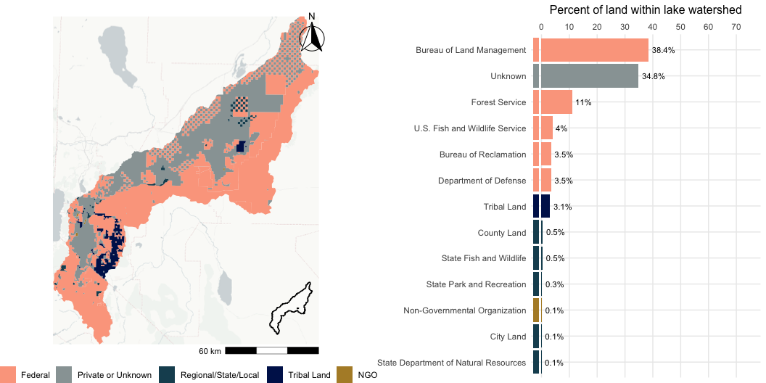
Carson Lake, NV

Slide 5
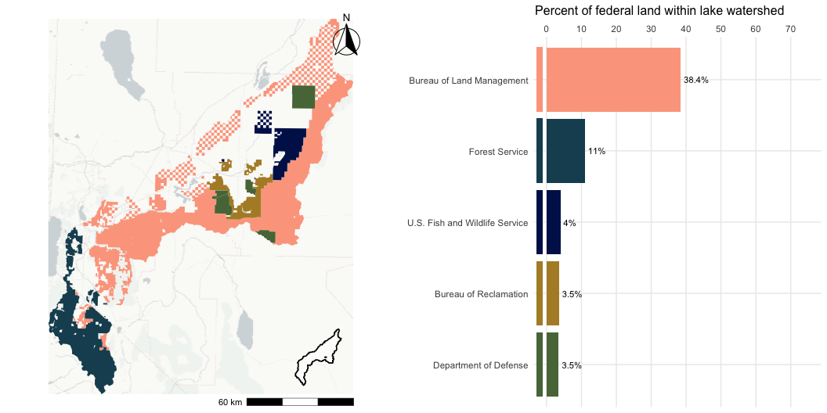
Carson Lake, NV - Federal Lands

Slide 6
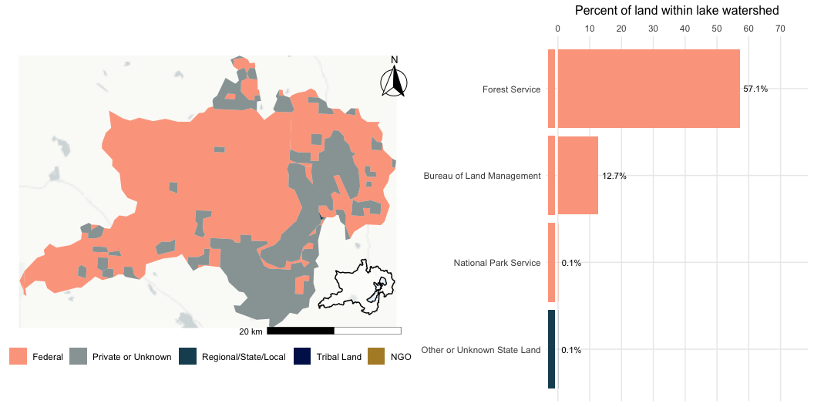
Eagle Lake, CA

Slide 7
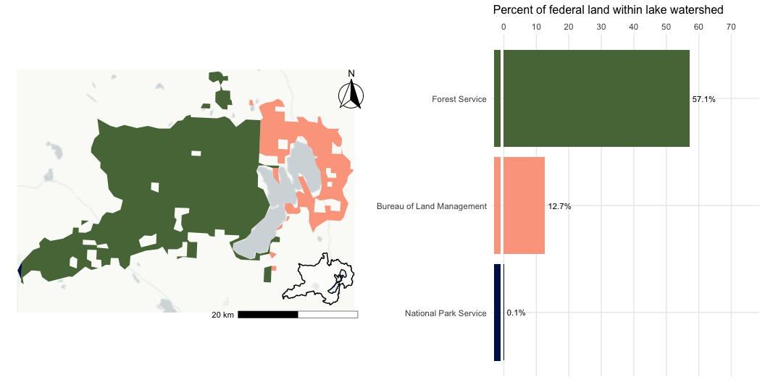
Eagle Lake, CA - Federal Lands

Slide 8
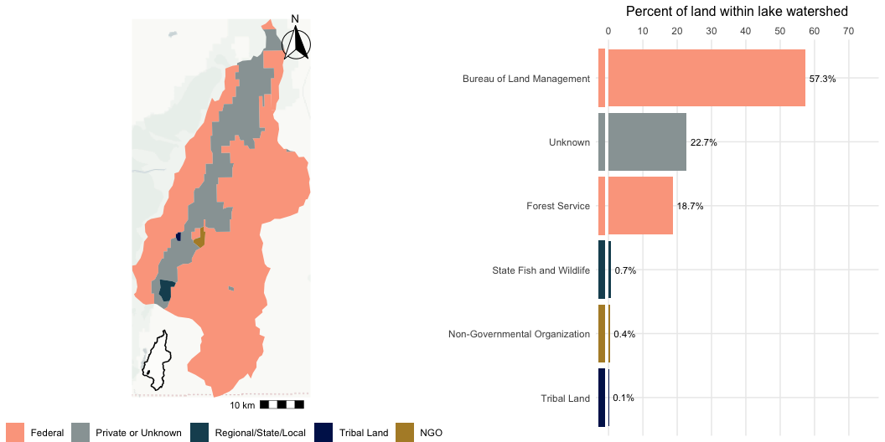
Franklin Lake, NV

Slide 9
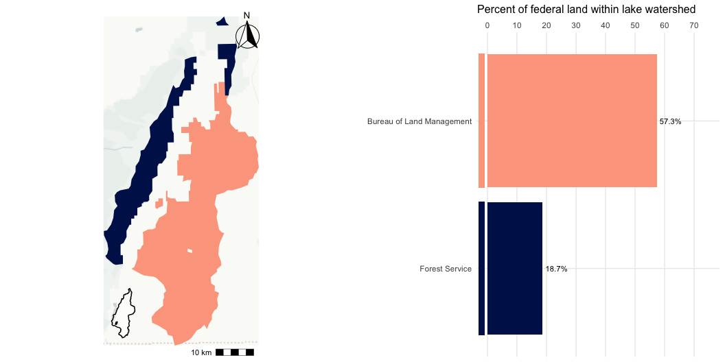
Franklin Lake, NV - Federal Lands

Slide 10
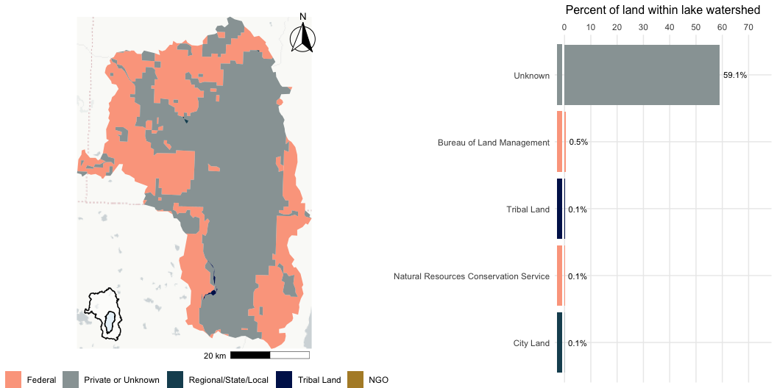
Goose Lake, CA

Slide 11
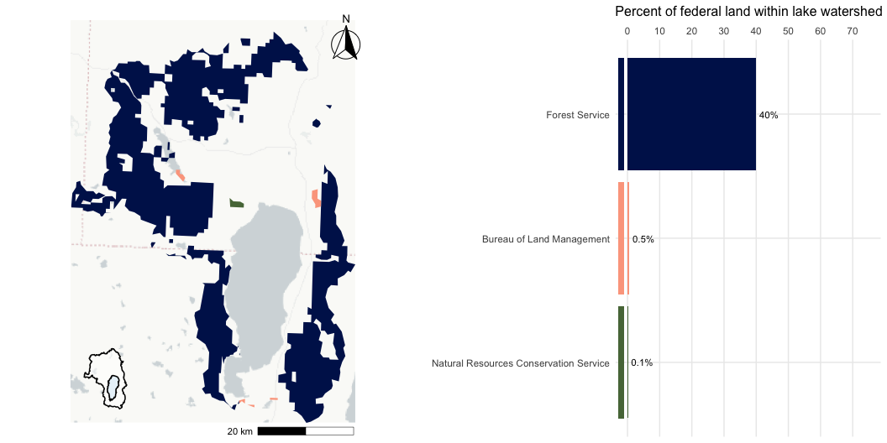
Goose Lake, CA - Federal Lands

Slide 12
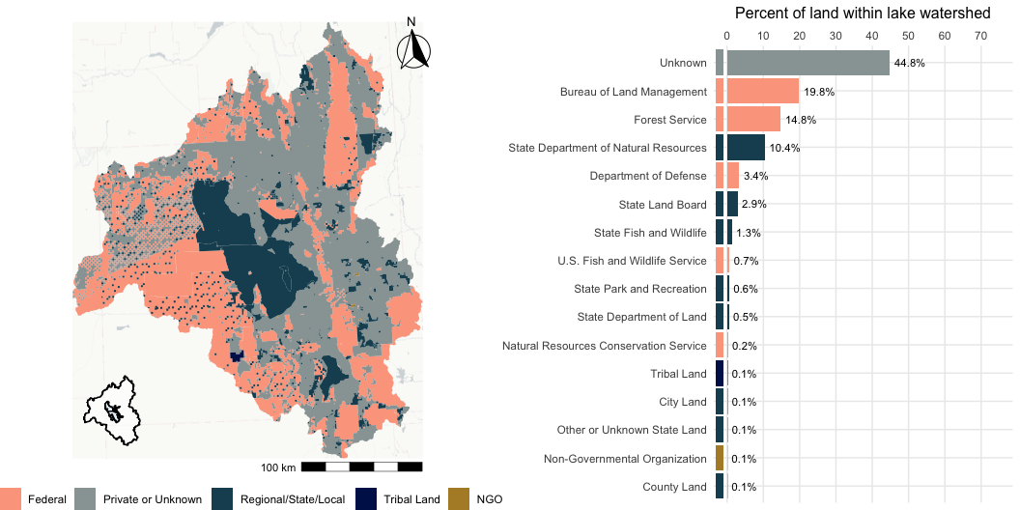
Great Salt Lake, UT

Slide 13
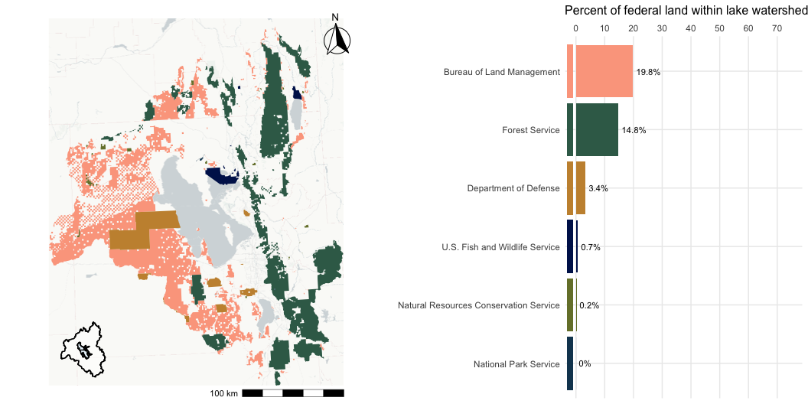
Great Salt Lake, UT - Federal Lands

Slide 14
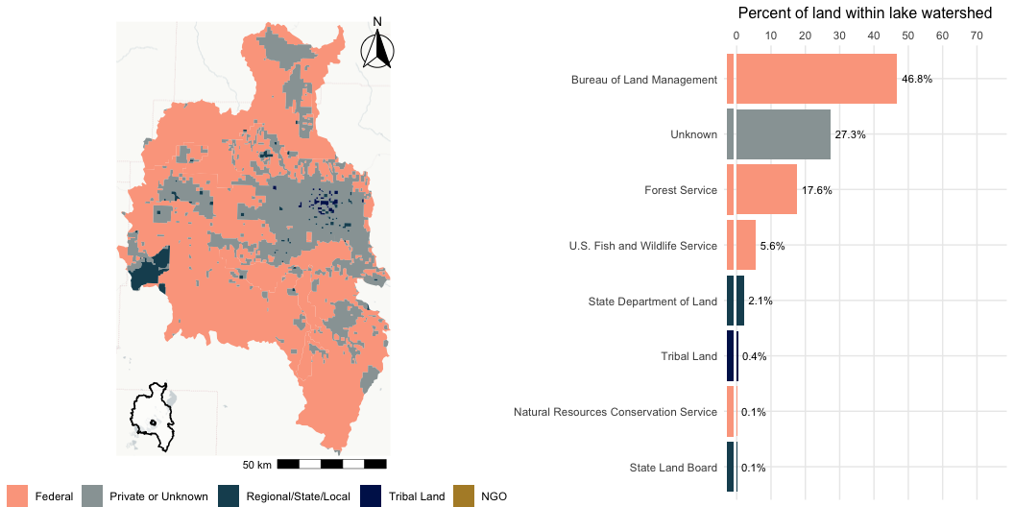
Harney Lake, OR

Slide 15
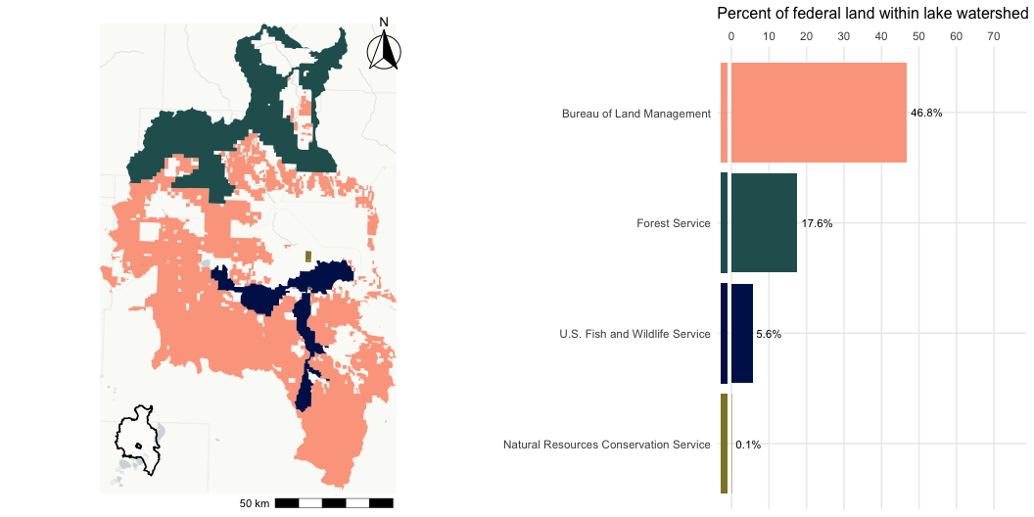
Harney Lake, OR - Federal Lands

Slide 16
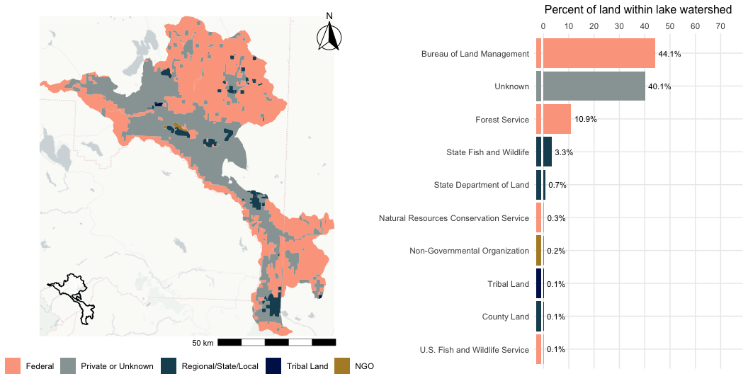
Honey Lake, CA

Slide 17
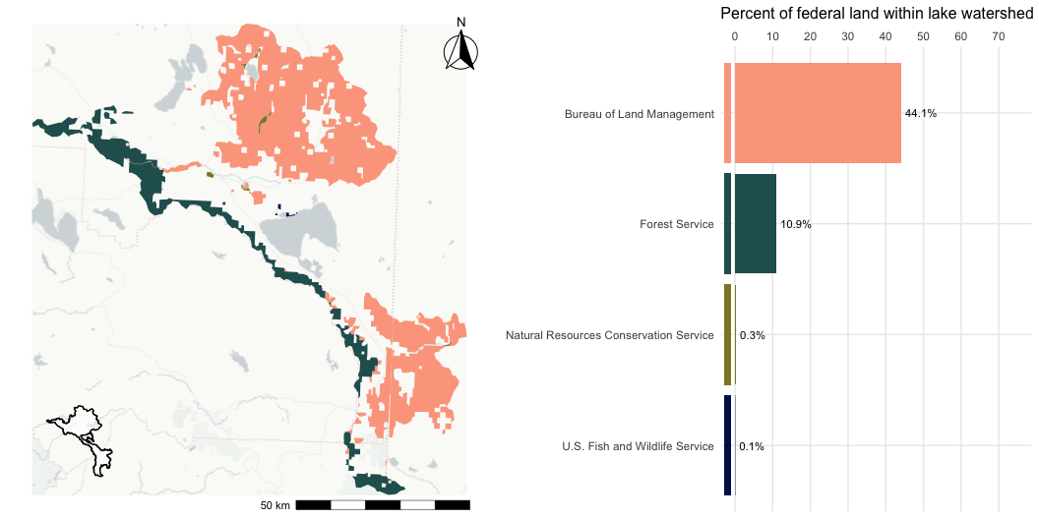
Honey Lake, CA - Federal Lands

Slide 18
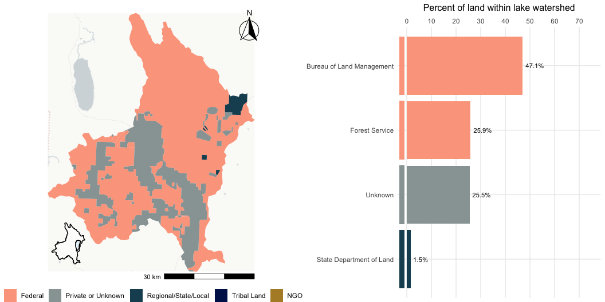
Lake Abert, OR

Slide 19
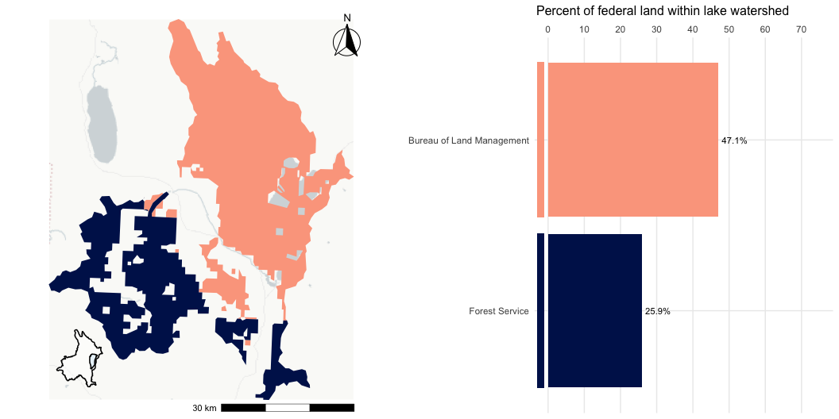
Lake Abert, OR - Federal Lands

Slide 20
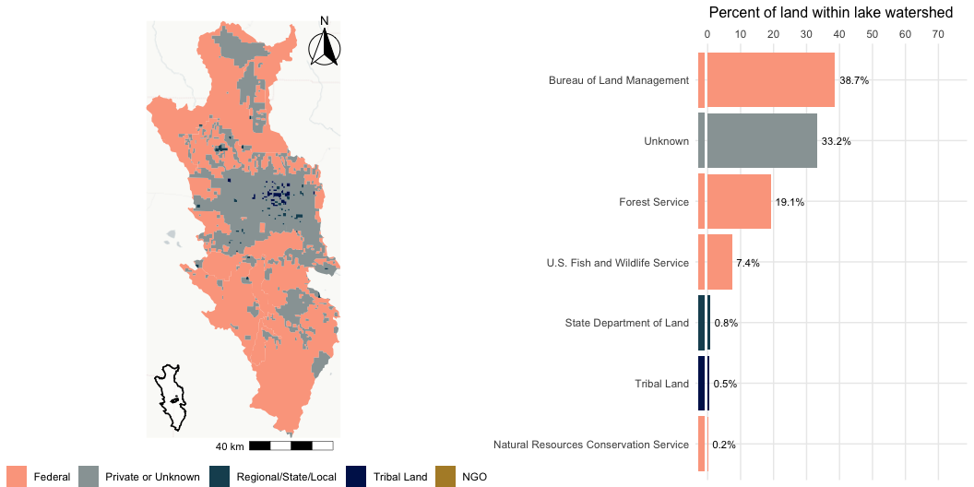
Malheur Lake, OR

Slide 21
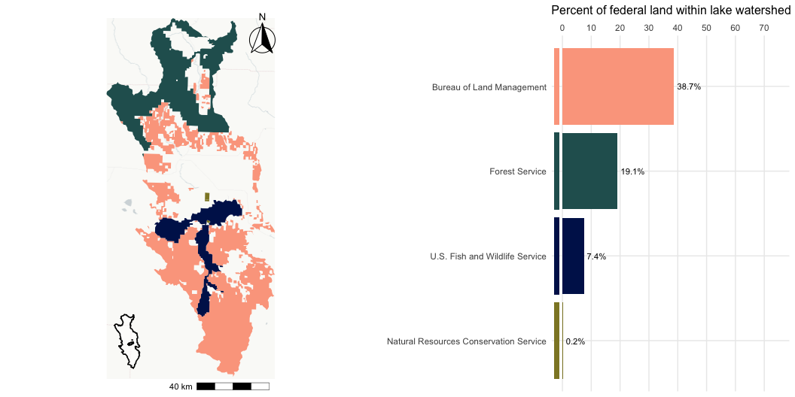
Malheur Lake, OR - Federal Lands

Slide 22
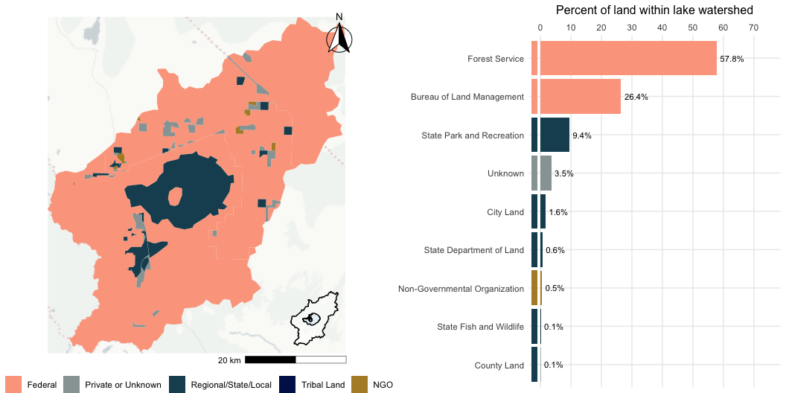
Mono Lake, CA

Slide 23
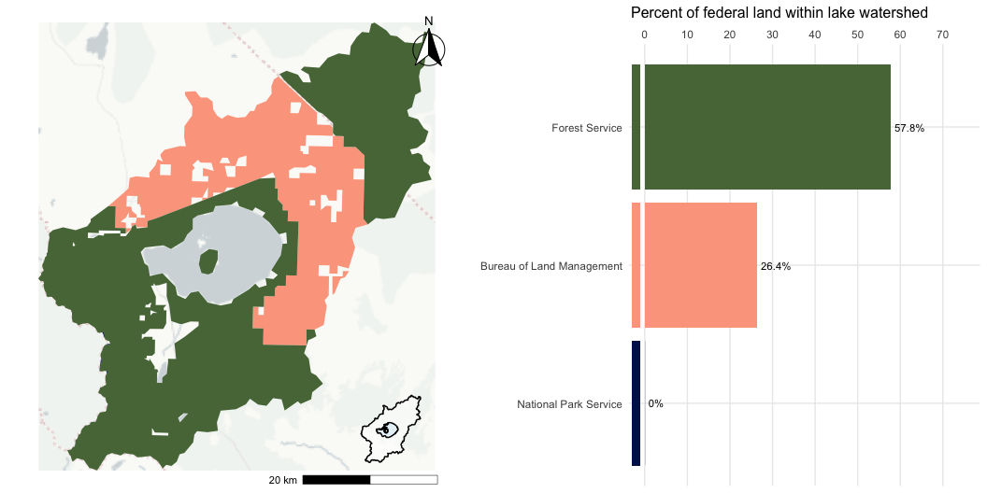
Mono Lake, CA - Federal Lands

Slide 24
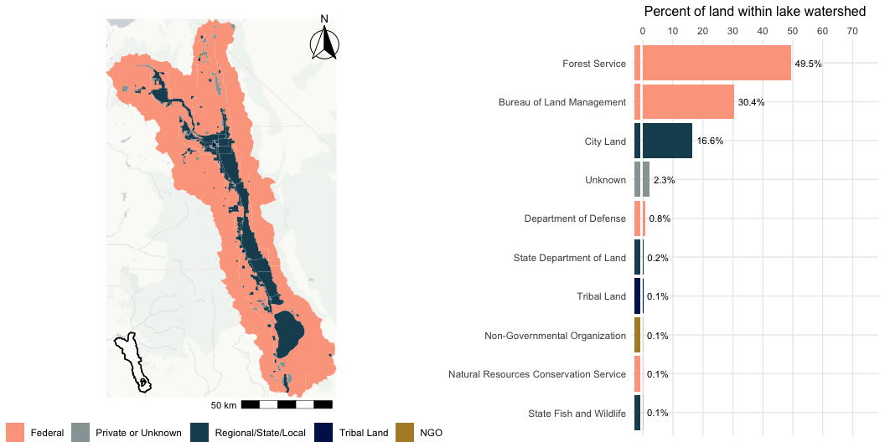
Owens Lake, CA

Slide 25
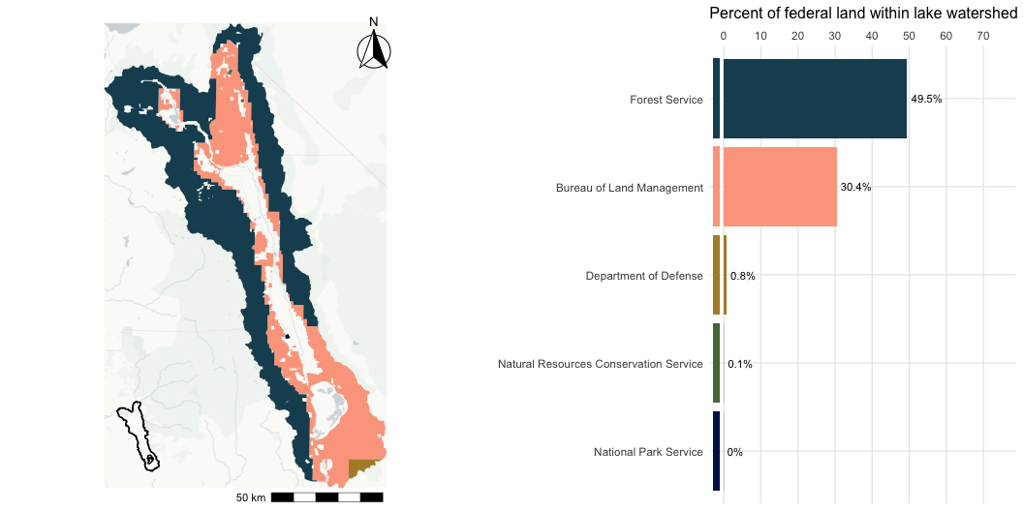
Owens Lake, CA - Federal Lands

Slide 26
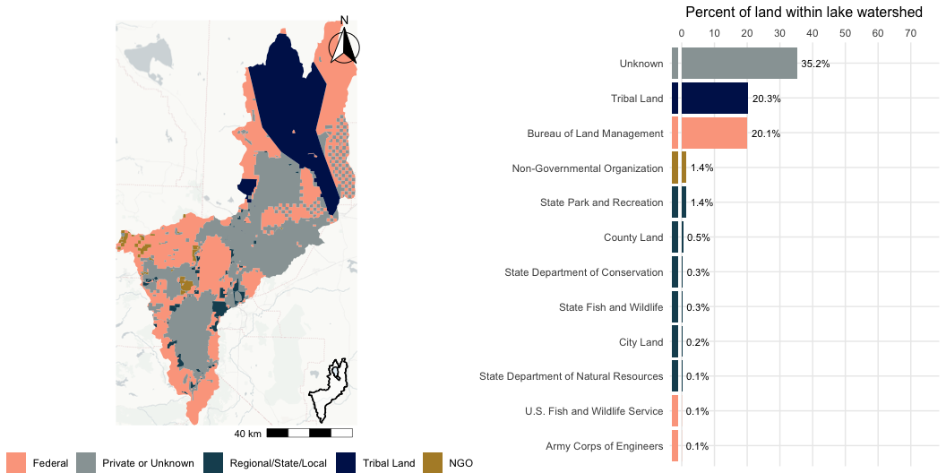
Pyramid Lake, NV

Slide 27
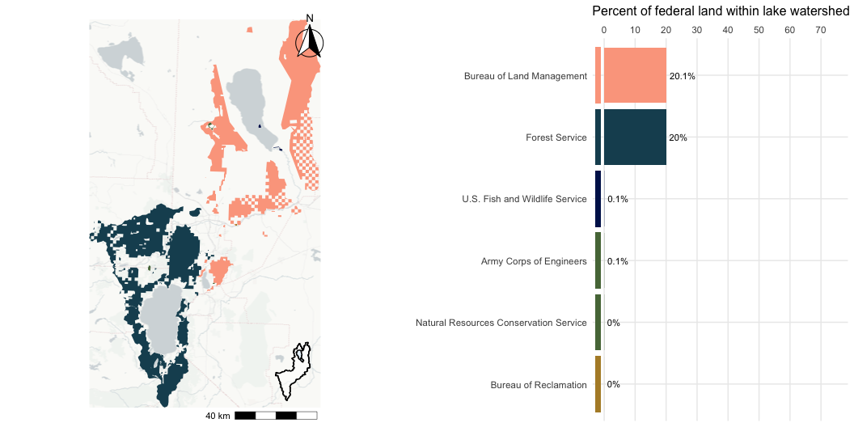
Pyramid Lake, NV- Federal Lands

Slide 28
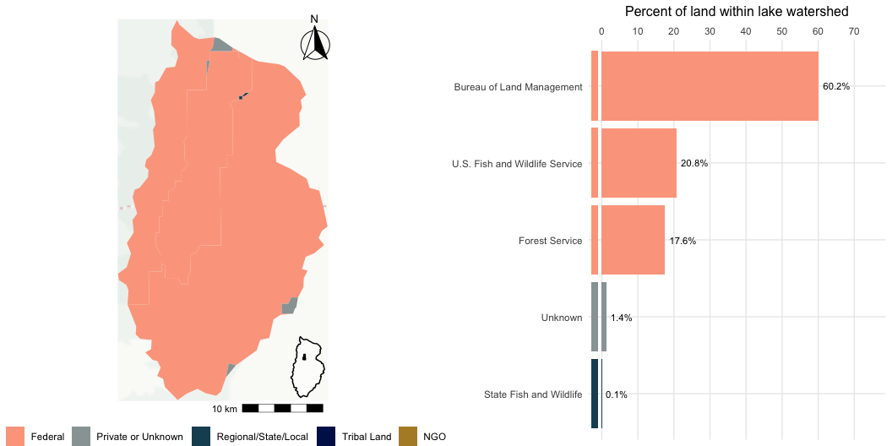
Ruby Lake, NV

Slide 29
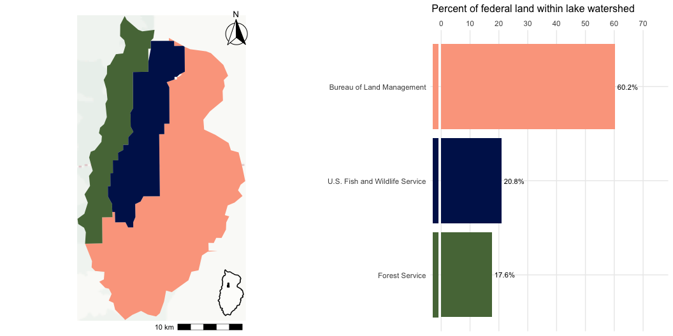
Ruby Lake, NV - Federal Lands

Slide 30
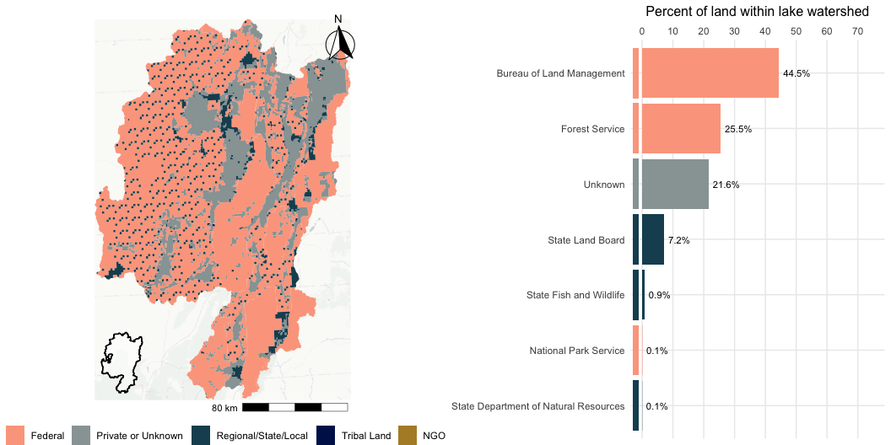
Sevier Lake, UT

Slide 31
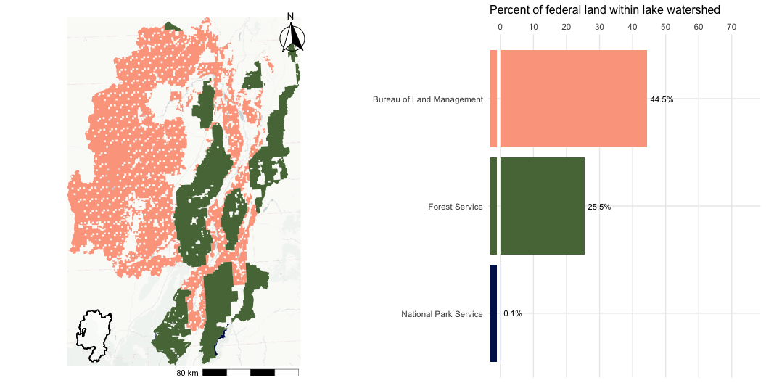
Sevier Lake, UT - Federal Lands

Slide 32
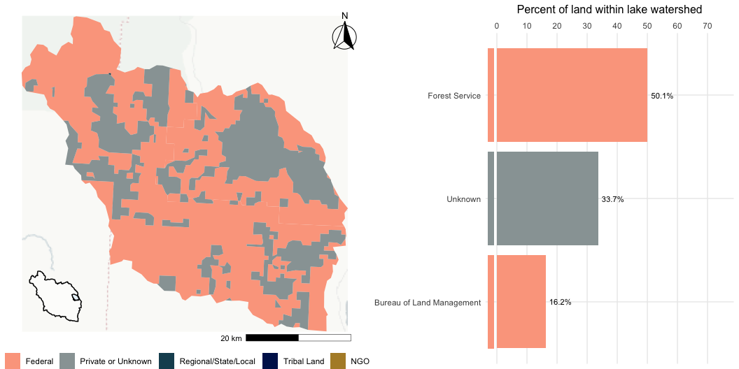
Silver Lake, OR

Slide 33
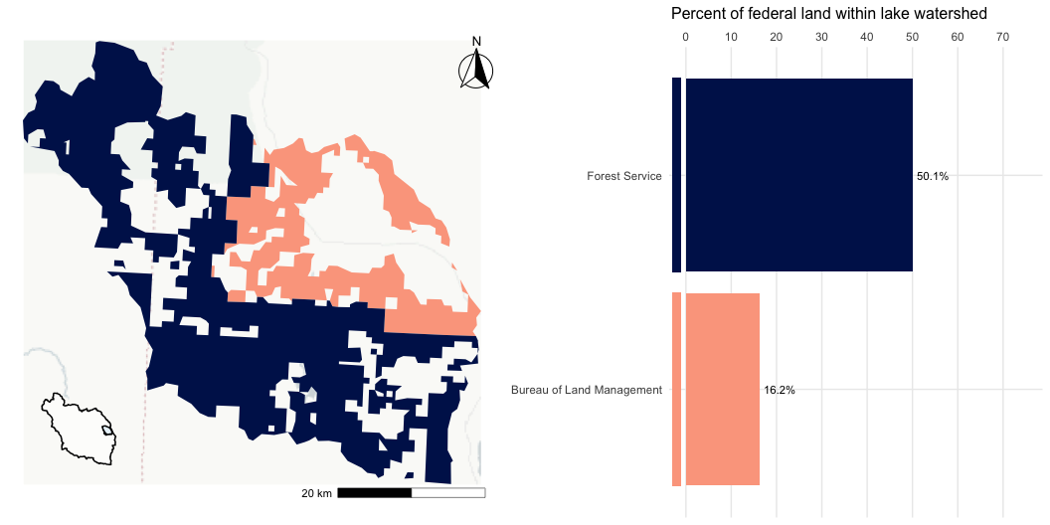
Silver Lake, OR - Federal Lands

Slide 34
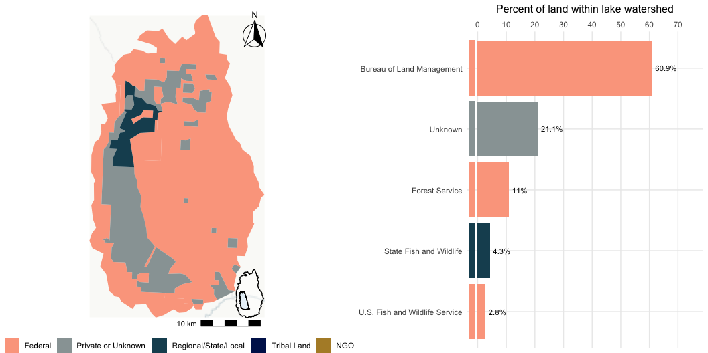
Summer Lake, OR

Slide 35
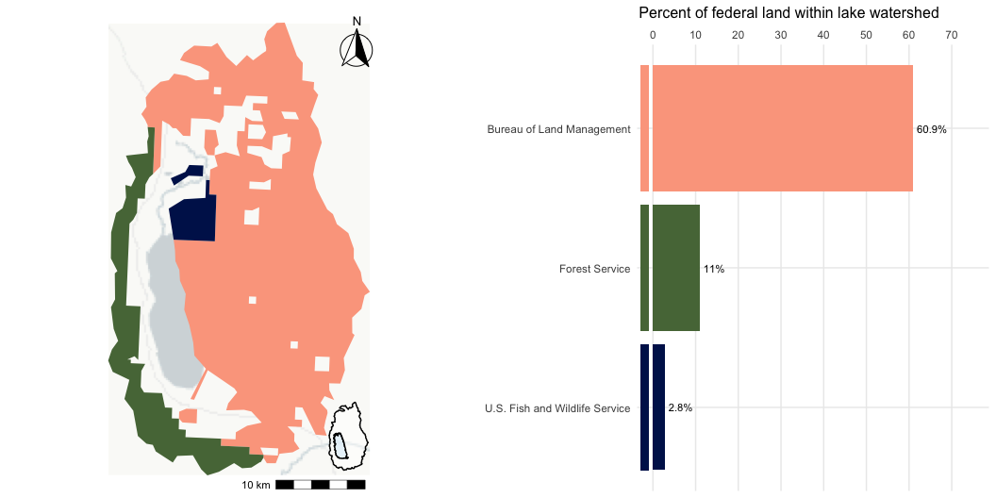
Summer Lake, OR - Federal Lands

Slide 36
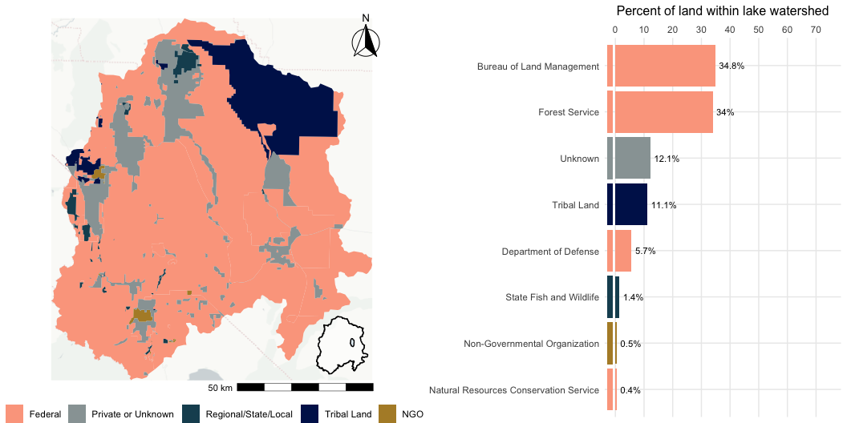
Walker Lake, NV

Slide 37
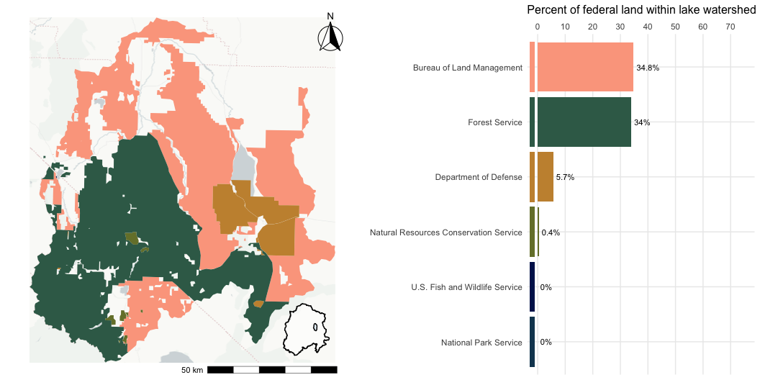
Walker Lake, NV- Federal Lands

Slide 38
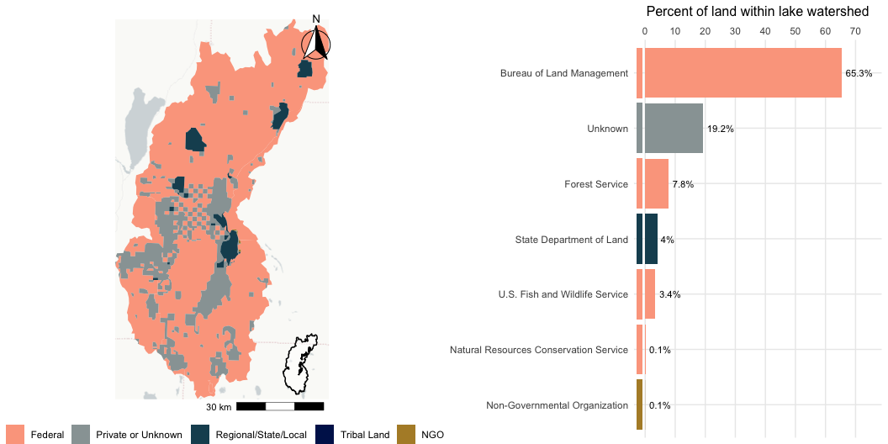
Warner Lake, OR

Slide 39
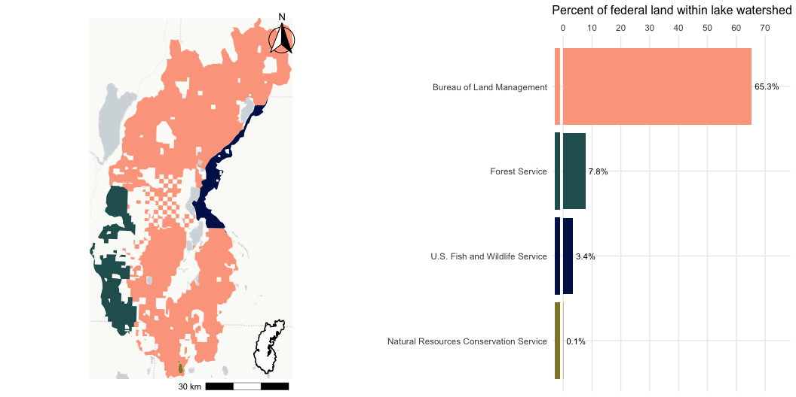
Warner Lake, OR- Federal Lands

Slide 40
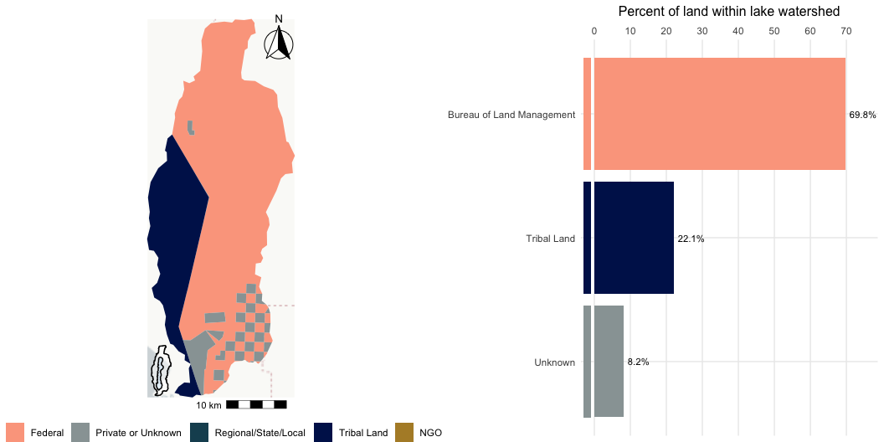
Winnemucca Lake, NV

Slide 41
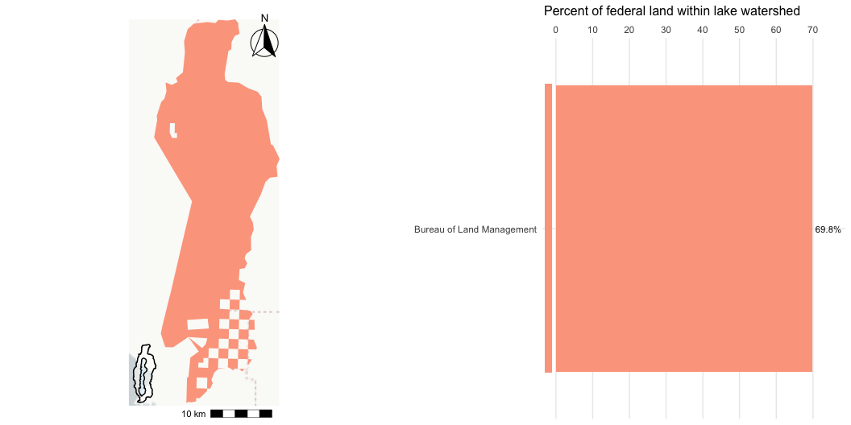
Winnemucca Lake, NV - Federal Lands

